Slide 1
Decision Trees and Ensembling
Metis Intro to Data Science
Fall 2018

Slide 2
Decision Trees
Goal: Segmenting the predictor space into a number of simple regions
Benefits: Easily Interpretable
Drawbacks: Variance and accuracy
Regression trees
Response is continuous
Use the mean of the region as the predictive value
Classification trees
Response is discrete (classes)
Use the mode of the region as the predictive value

Slide 3
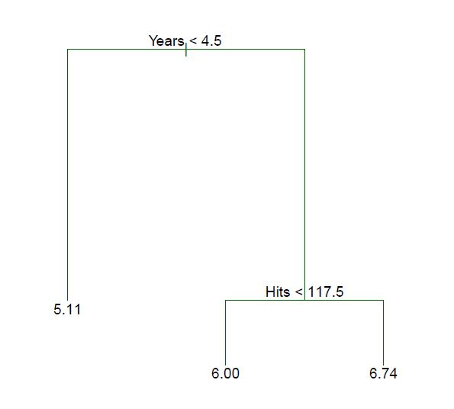
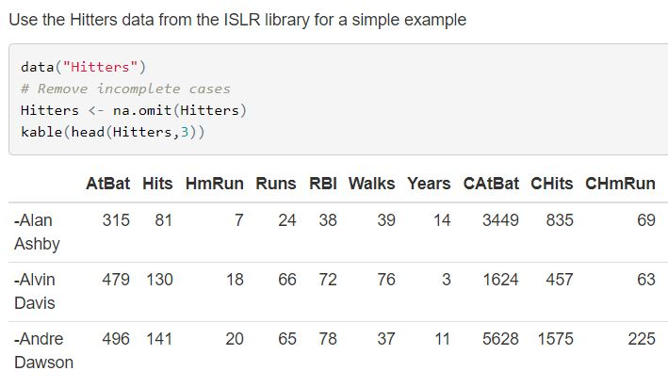
Decision Trees
From ISLR: hitters data set
Interpretable anatomy

Slide 4
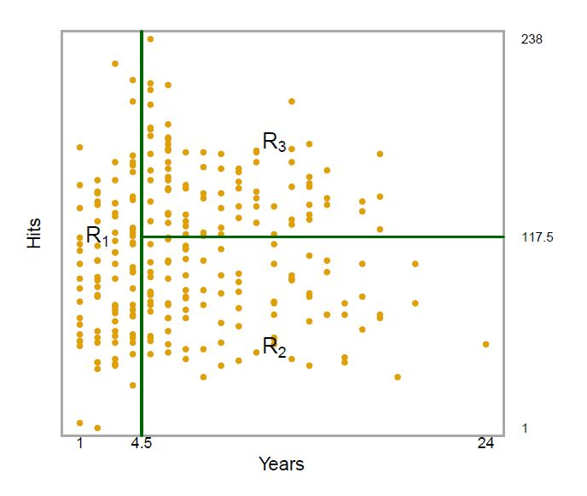
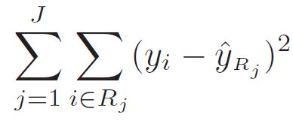
Decision Trees – Choosing regions
Divide the predictor space into J distinct and non overlapping regions
For every observation that falls into R_{j} we make the same prediction. The mean of the response values from the training set

Slide 5
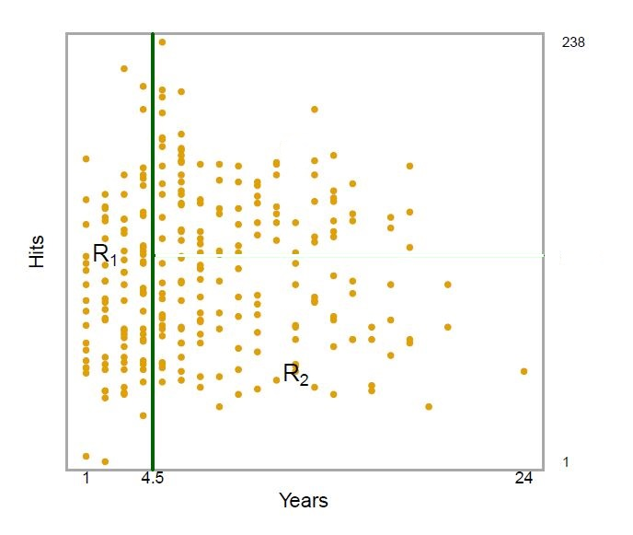
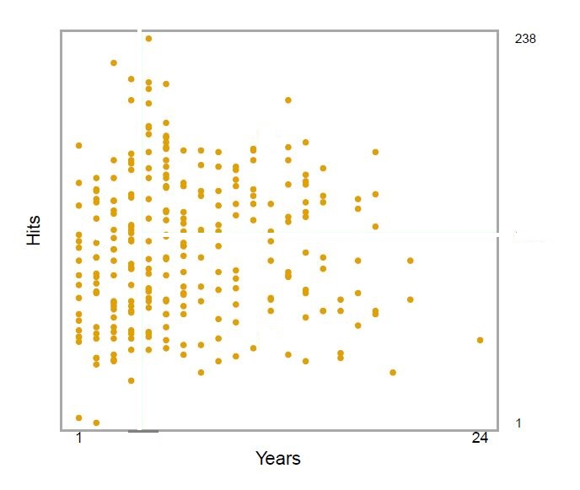
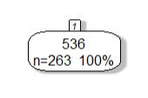
Decision Trees – Choosing regions
Recursive Binary Splitting – greedy approach
Start from the top of the tree where all the observations are in one single region
Greedy because only the best split is made at that particular step, rather than looking ahead and picking a split that will lead to a better tree in some future step

Slide 6
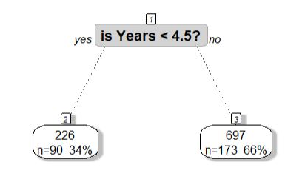
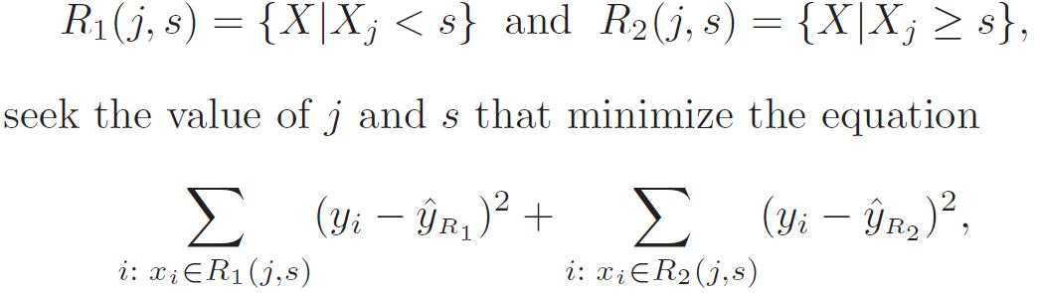
Decision Trees – Choosing regions
Successively split the predictor space
Each split will be indicated by 2 new branches down the tree

Slide 7
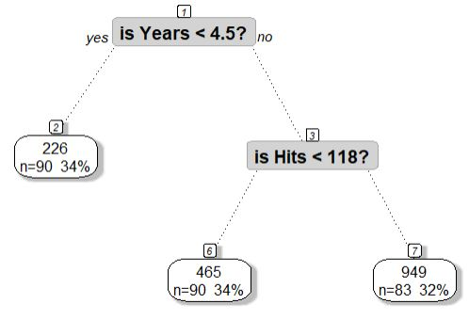
Decision Trees – Choosing regions
Repeat the process looking for the best predictor and best cut point
Minimize the Regional Sum of Squares

Slide 8
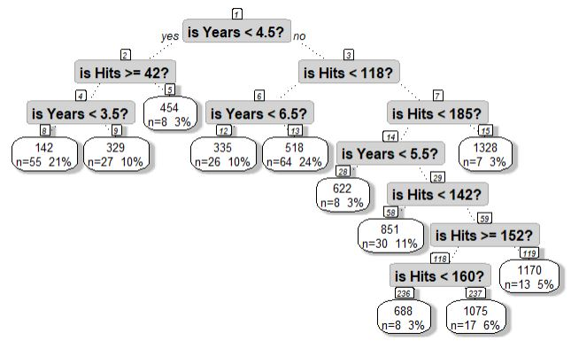
Decision Trees – Choosing regions
Process continues until it reaches a stopping criterion
Example: Limit the number of observations in a node to 5
We can now predict a new test observation by returning the mean of the training observations in the given region

Slide 9
Decision Trees – Pruning
Full tree may over fit the training dataset, leading to poor prediction on test.
Pruning will lower the variance and increase the bias
Consider sub-trees and look for the one with the lowest test error using cross validation

Slide 10
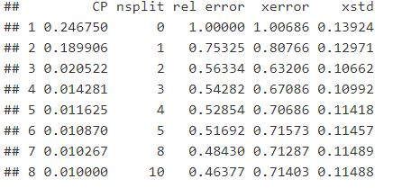
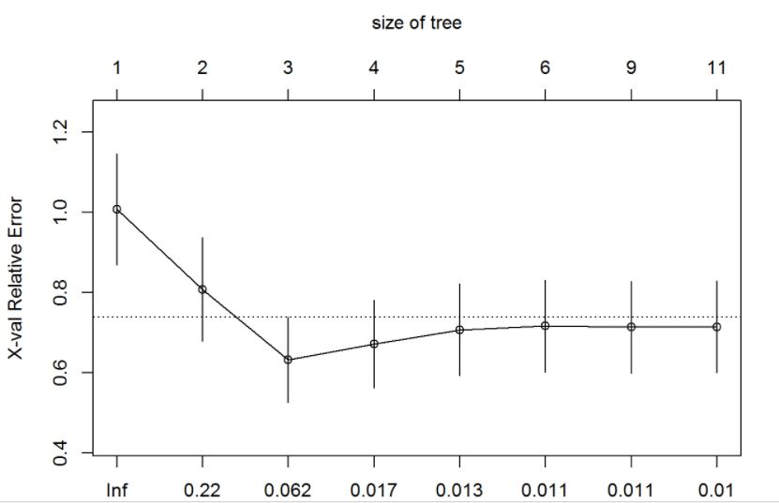
Decision Trees – Pruning
For each additional node (sub tree)
Run cross validation
Return the error
Select the tree with the lowest error

Slide 11
Decision Trees – Pruning Pruned tree

Slide 12
Decision Trees – Classification
Used to predict a qualitative response vs a quantitative response
Using the mode of the region’s observations instead of the mean
Also interested in the class proportions of observations per region

Slide 13
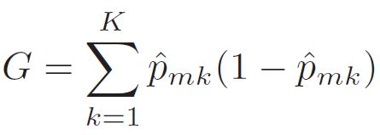
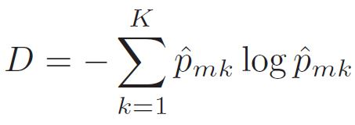
Decision Trees – Classification
Process is the same as regression trees, except splitting criterion
Gini Index – measure of node purity – how often an element is labeled correctly
P_{mk} represents the proportion of observations in the mth region from the kth class
Small value indicates that a node predominantly contains observations from a single class
Cross Entropy – alternative measure of purity

Slide 14
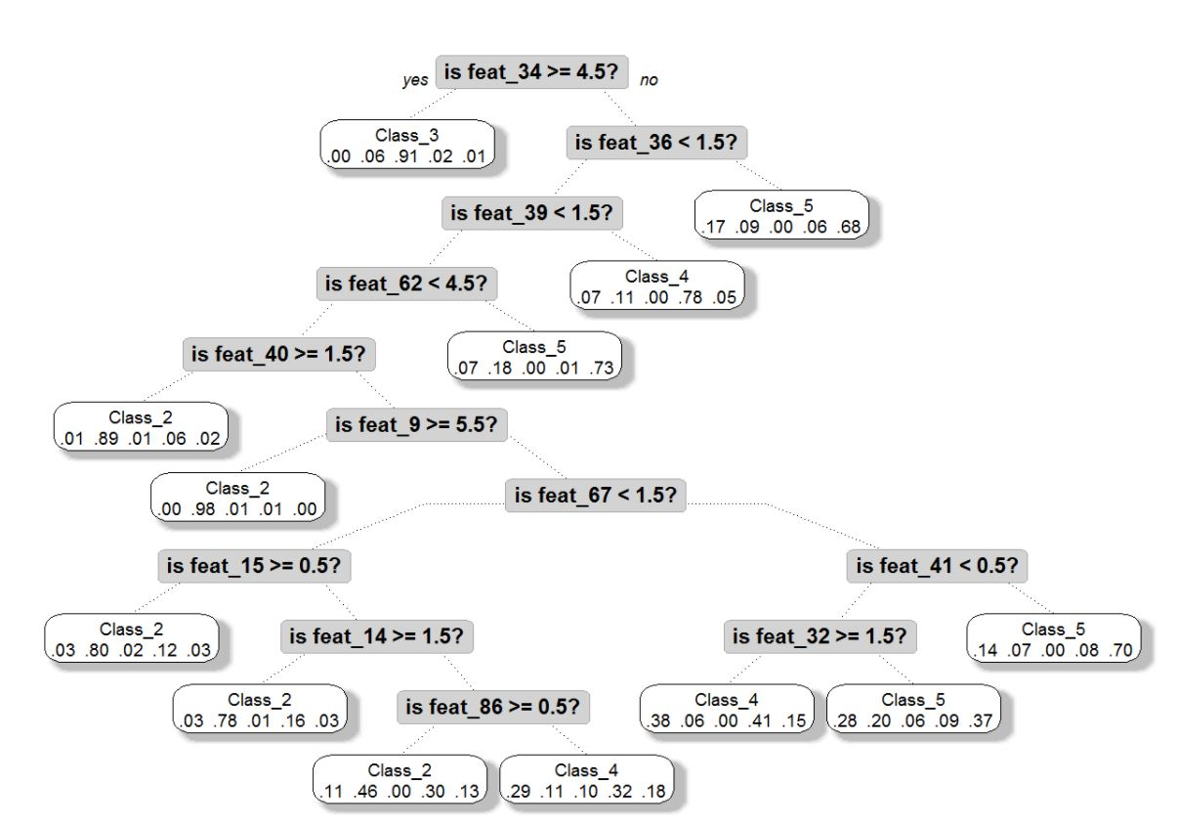
Decision Trees – Classification
Fully grown Classification Tree
Nodes show
Proportion of classes
Mode/prediction of node

Slide 15
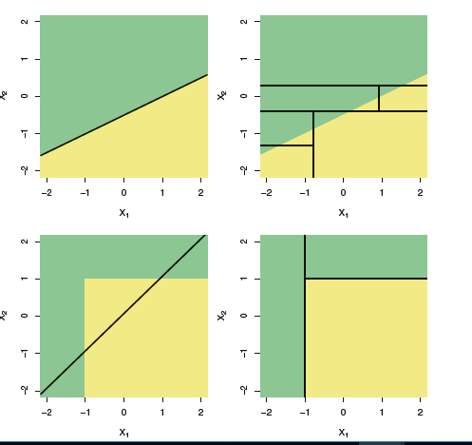
Trees vs Linear Model Depends on how the separation of the data is composed
Top row: Linear classifier provides a better fit than trees for a linear space
Bottom row: Trees provide a better fit for non linear space

Slide 16

Ensembling – Improving Trees
Biggest problem with building a decision tree is high variance.
Solution is ensembling
We can use multiple trees to get more accurate predictions and lower the variance

Slide 17
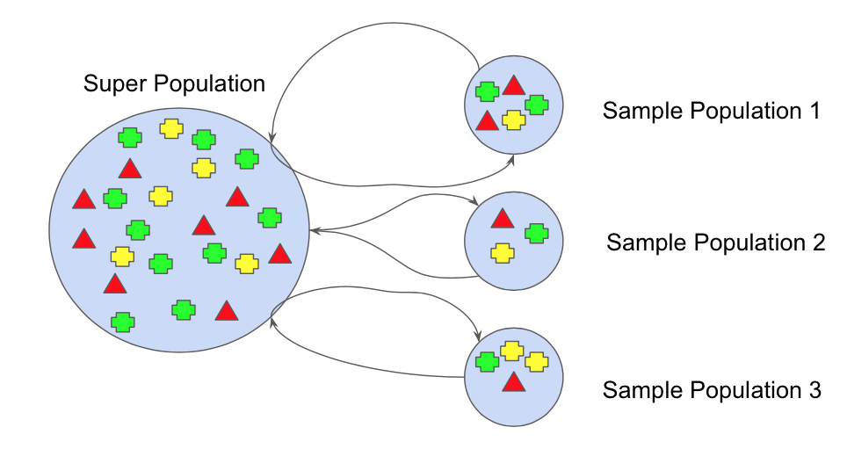

Ensemble 1 – Bagging Bootstrap Aggregation
Step 1
bootstrap the data & create data set 1
build dec tree 1
Step 2
bootstrap the data & create data set 2
build dec tree 2
Step n
bootstrap the data & create data set n
build dec tree n
Final Step
Aggregate predictions
Regression – mean
Classification - mode
n
Aggregate predictions

Slide 18
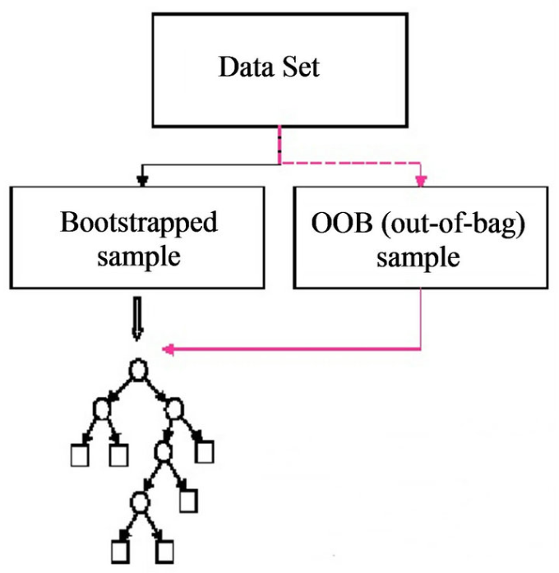
Ensemble 1 – Bagging Bootstrap Aggregation
OOB Out of Bag observations
Bootstrap method uses 2/3 of the data, 1/3 is for the test set

Slide 19
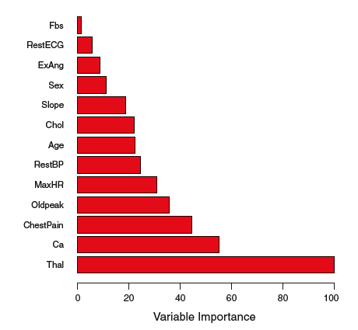
Ensemble Interpretation Feature Importance
Interpretation of the features is lost because we have many trees
Different trees and different features combine to give the aggregated prediction
Remove one feature and measure how much error changes
Importance is relative to the most important predictor

Slide 20
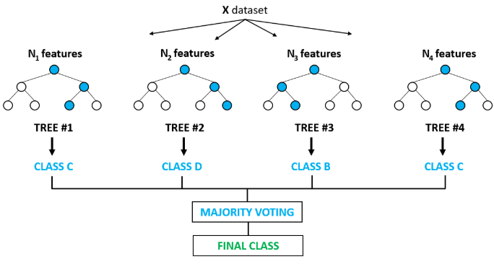

Ensemble 2 – Random Forest
Random Forest is very similar to Bagging
Difference is in how we make our splits (which features we consider)
Every time we make a split, we take a random sample of subset of N features
Regression subset: $N/3$
Classification subset:$√N$
Aggregate predictions

Slide 21
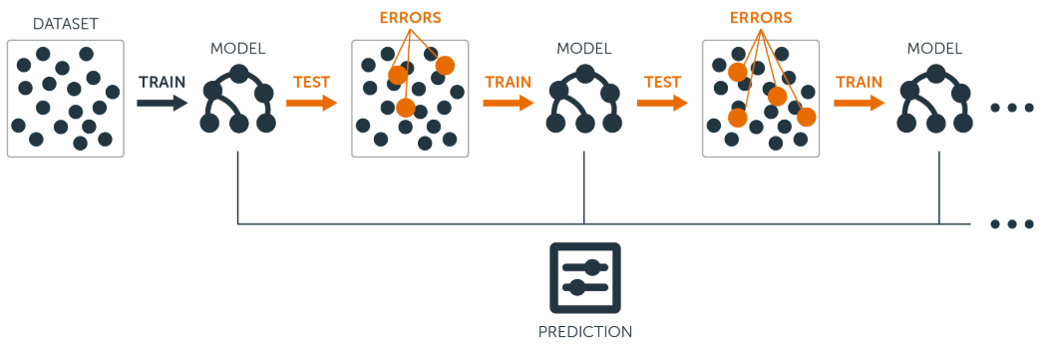

Ensemble 3 – Gradient Boosted Trees
Difference is trees sequential and dependent
Residual output of the first tree is the input to the next tree
Typically use short trees (stumps)
Slow learner progresses to become powerful
Learning rate parameter
$λ=0.01 or 0.001$
Regression or Classification tasks

Slide 22
Questions?

